Slide 1

Broad Approaches to Migrating into Cloud
Dr. Saroja Kumar Rout
Associate Professor
Department of IT
Vardhaman College of Engineering

Slide 2
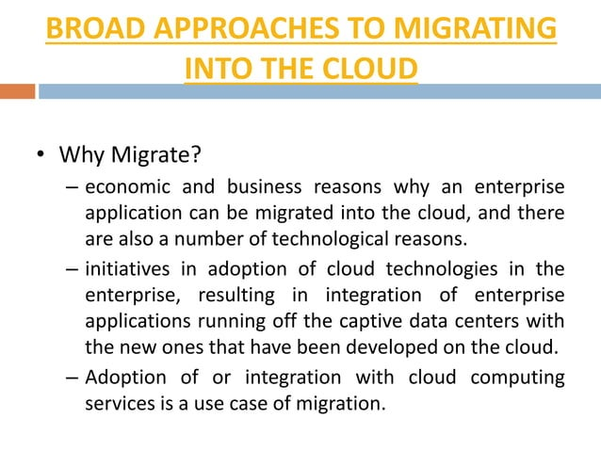

Slide 3
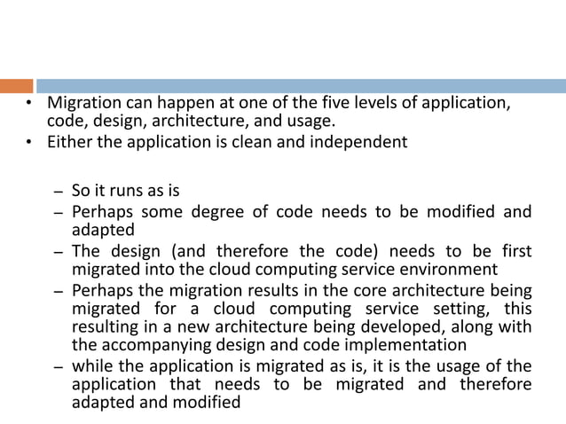

Slide 4
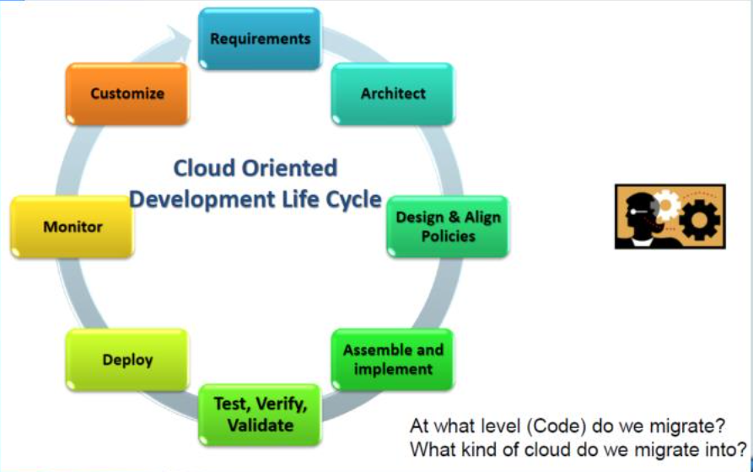

Slide 5
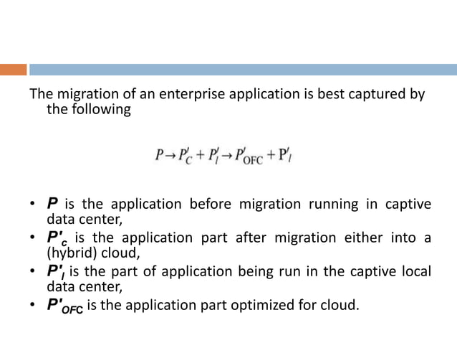

Slide 6
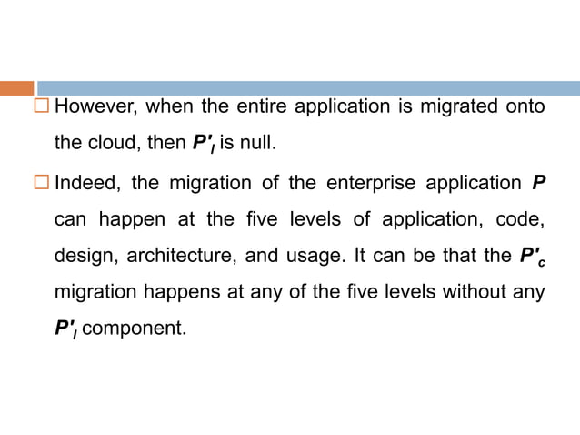

Slide 7
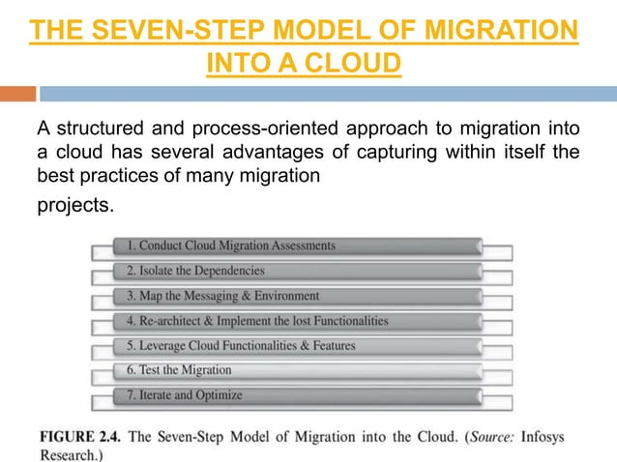
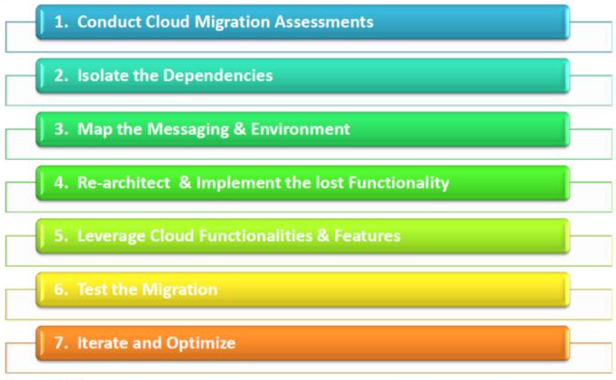

Slide 8
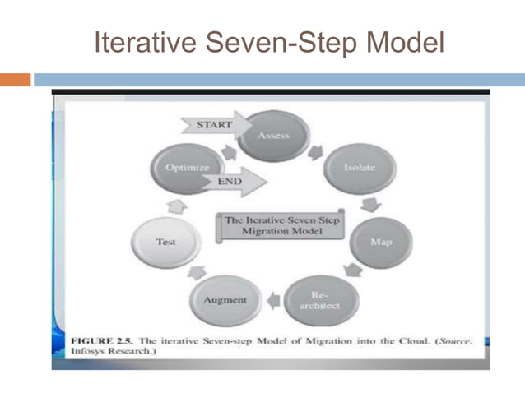

Slide 9
The Seven-Step Model of Migration into a Cloud
Step 1
Cloud migration assessments comprise assessments to understand the issues involved in the specific case of migration at the application level or the code, the design, the architecture, or usage levels.
These assessments are about the cost of migration as well as about the ROI that can be achieved in the case of production version.
Step 2
isolating all systemic and environmental dependencies of the enterprise application components within the captive data center
Step 3
generating the mapping constructs between what shall possibly remain in the local captive data center and what goes onto the cloud.

Slide 10
The Seven-Step Model of Migration into a Cloud
Step 4
substantial part of the enterprise application needs to be rearchitected, redesigned, and reimplemented on the cloud
Step 5
We leverage the intrinsic features of the cloud computing service to augment our enterprise application in its own small ways.
Step 6
we validate and test the new form of the enterprise application with an extensive test suite that comprises testing the components of the enterprise application on the cloud as well
Step 7
Test results could be positive or mixed.
In the latter case, we iterate and optimize as appropriate. After several such optimizing iterations, the migration is deemed successful

Slide 11
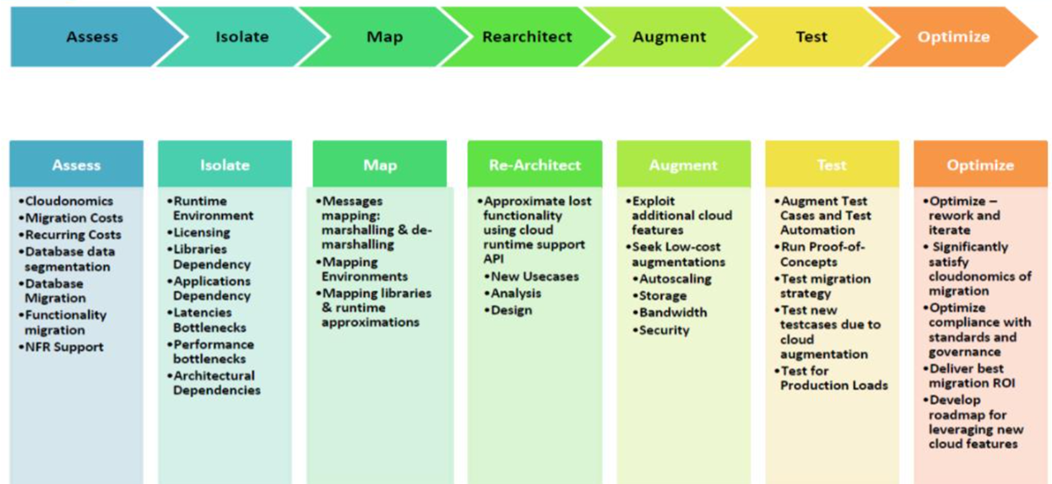

Slide 12
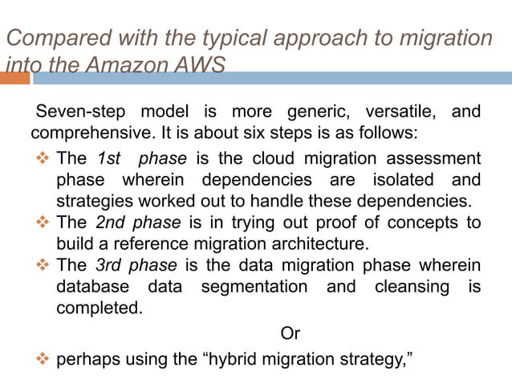

Slide 13
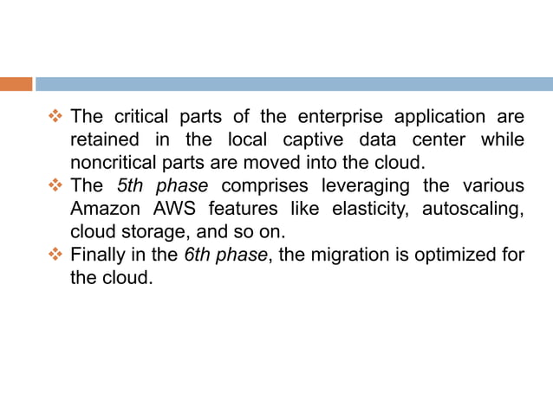

Slide 14
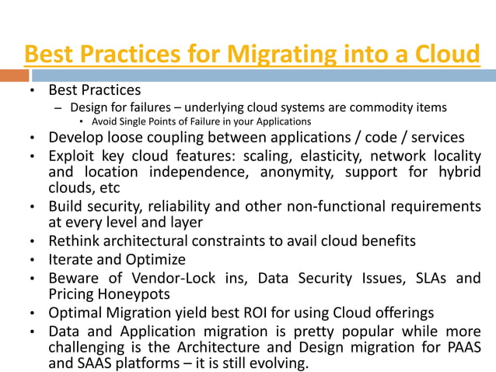

Slide 15
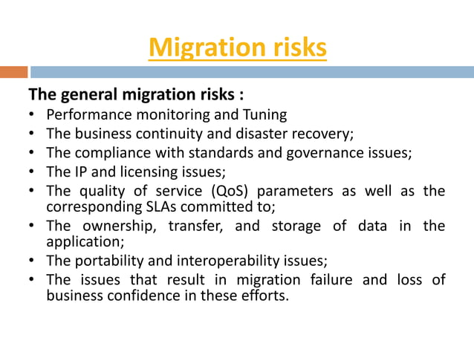

Slide 16
